Slide 1
Topic 9
Algae
al-Farabi Ka akh National University
Faculty of Biology and biotechnology
Department of Biodiversity and Bioresources

Slide 2
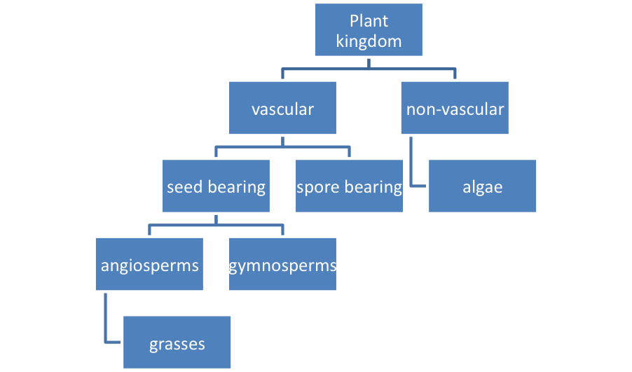
Plant Classification
While there are many ways to structure plant classification, one way is to group them into vascular and non-vascular plants, seed bearing and spore bearing, and angiosperms and gymnosperms. Plants can also be classified as grasses, herbaceous plants, woody shrubs, and trees.
Example of Plant Classification

Slide 3
All living organisms can be divided into a few major kingdoms. The kingdoms commonly recognized include: Archaea and Bacteria (the prokaryotic kingdoms), Protista, Fungi, Plantae, and Animalia. Those organisms that carry out photosynthesis include the cyanobacteria in kingdom Bacteria, the algae in kingdom Protista, and the plants in kingdom Plantae.
Within each kingdom, the scientists have established six basic hierarchical groupings:
Phyla (or Divisions in the Plantae kingdom)
Classes
Orders
Families
Genera
Species
Each species has a scientific name which is a Latin binomial. The binomial is composed of the genus name and the specific epithet (the add-on name of the species).

Slide 4
INTRODUCTION TO ALGAE
1-GENERAL CHARACTERISTICS
1-Size Criterion: picoplankton (<1-2 mm), nanoplankton (2-20 mm),
microplankton (> 20 mm)
2- Most reproduce asexually
3- Both heterotrophic and autotrophic organisms exist
4- Increased importance of heterotrophy with reduced light and/or
nutrients
5-Current estimates suggest that between 4,000 – 5,000 of marine
phytoplankton species have been described. Freshwater diversity is
probably higher!
6- Phylogeny: Occupy two domains (Bacteria and Eucarya), and at least 12 phyla.

Slide 5
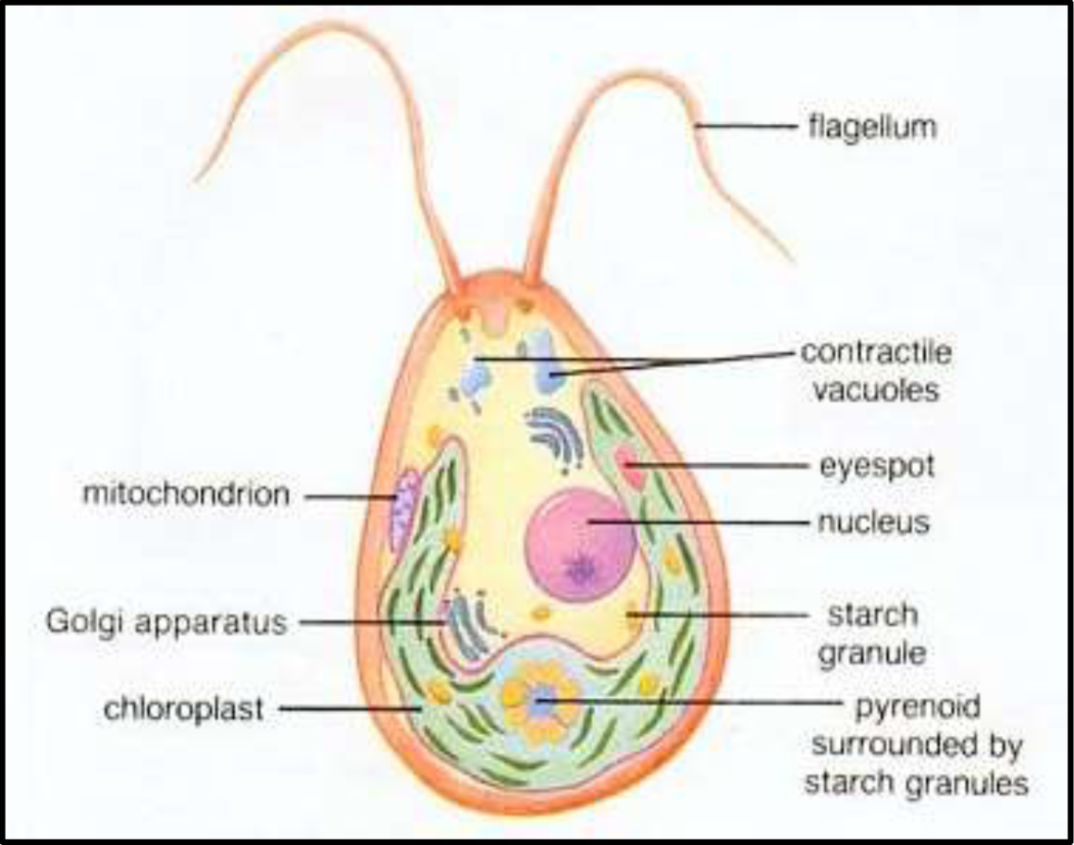
MORPHOLOGY OF AN ALGAL CELL

Slide 6
2-ALGAL HABITAT
Algae are a group of ubiquitous organisms which are present in diverse habitats such as water (aquatic algae), land (terrestrial algae), they also grow as an epiphyte, endophyte, and as well as in extreme conditions,
1-Planktonic: ‘free-floating’.
2- Attached:
A-Epipelic: On Sediment
B-Epiphytic: In Aquatic Vegetation (Macrophytes)
C-Epilithic: On rocks.
D-Episammic: On sand.

Slide 7
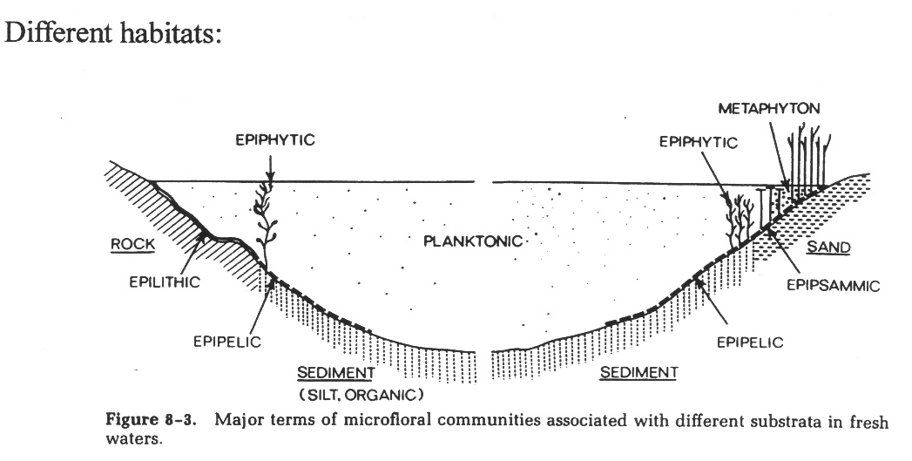
Fig. 1: Different habitat of Algal Community

Slide 8
3 - MORPHOLOGY OF ALGAE
1-Unicellular
Unicellular algae consist of a single cell. The single cell of the body contains a chloroplast, which conducts photosynthesis to create energy from sunlight, and often contains a structure called a pyrenoid that can store energy and contractile vacuoles that help to regulate the amount of water and salts within the cell (i.e., osmoregulation), with or without flagella. Some unicellular algae such as Chlamydomonas are motile, or able to move, using flagella. Non-motile unicell – Chlorella.

Slide 9
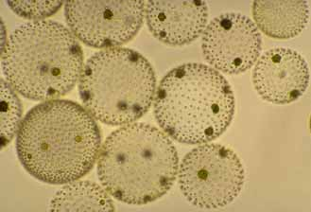
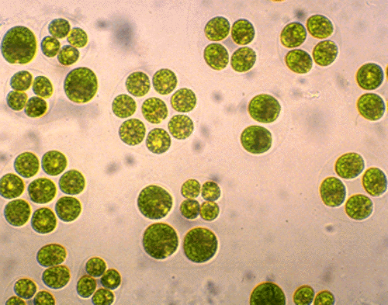
2-Colonial
Colonial algae include different numbers of cells. Some, such as Gonium, consist of a small group of cells, whereas others, such as Volvox, consist of hundreds of cells. Specialized colonies called coenobium contain a specific number of cells, each with their own tasks, that cannot survive alone. Like unicellular algae, many colonial algae are motile.
Fig. 3 Volvox is an example of a motile coenobium
Fig. 4 Oocystis is an example of a colonial green alga

Slide 10
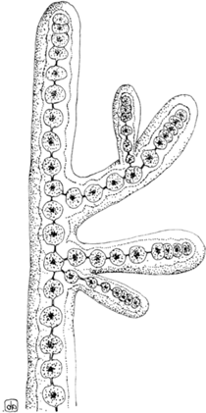
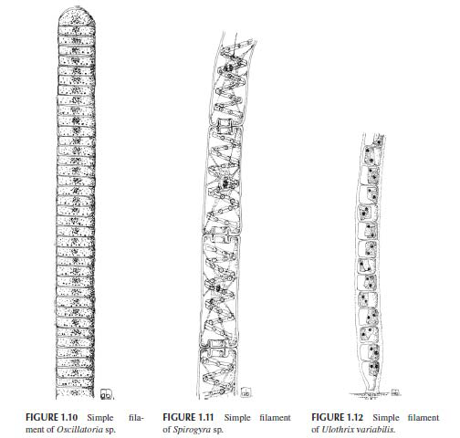
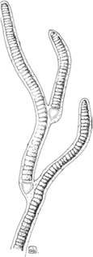
3-Filamentous Type
Filamentous algae undergo cell division but remain connected, forming long filaments of attached cells. Each cell within the filamentous alga has its own internal structures, such as a chloroplast, and is capable of photosynthesis. Spirogyra is one commonly-studied alga. At low tide, this stringy, green algae is exposed on rocks. Under the microscope, Spirogyra reveals a unique, spiral arrangement of chloroplasts.
Fig. 5: Multicellular thalli, with a basically uniseriate filamentous, branched, or unbranched

Slide 11
Organization, composed of multinucleate cells as a consequence of uncoupled cell division and mitosis. Despite lacking clear physical borders, this morphotype is present in members of the class Ulvophyceae (Chlorophyta) such as Cladophora sp. and Anadyomene sp.

Slide 12
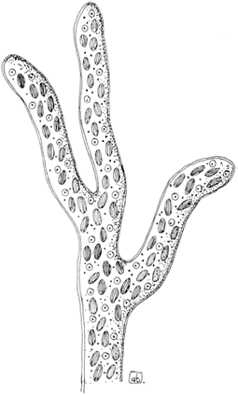
4-Siphonous Type
Siphonous algae have a morphology that superficially resembles that of filamentous algae. However, siphonous algae consist of only one single cell with branching sections. Enteromorpha is a siphonous algae that appears similar to Spirogyra to the naked eye.
Fig. 6: Siphonous thallus of Vaucheria sessilis.

Slide 13
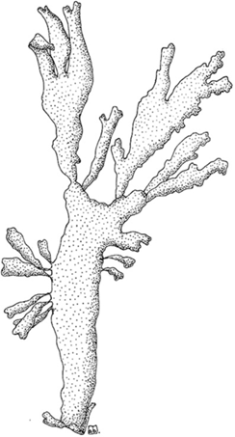
5-Parenchymatous and Pseudo-Parenchymatous Type
Certain red algae contain boxy, plant-like cells and have a complex, multicellular structure that is termed "parenchymatous“. Although the cells of algae do not truly differentiate to form various structures, these parenchymatous algae often have parts that resemble leaves, stems and roots. Kelp grows to immense lengths, and is perhaps one of the best-known parenchymatous algae.
Fig. 7: Pseudo-parenchymatous
thallus of Palmaria palmata.

Slide 14
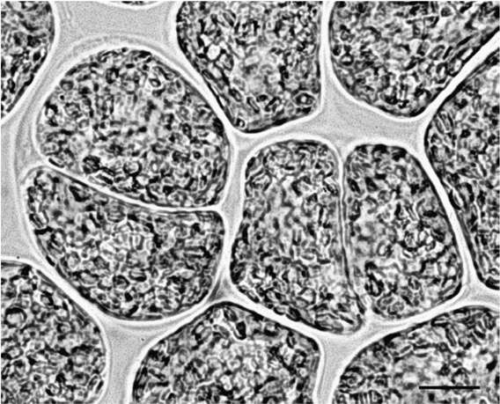
6-Palmelloid Type
Applied to an algal colony composed of an indefinite number of non-motile cells embedded in a gelatinous or mucilaginous matrix. It may occur as a non-motile phase in a normally motile species
Fig. 8: Palmelloid phase of Euglena gracilis

Slide 15
4-NUTRITION
Following our definition of the term algae, most algal groups should be considered photoautotrophs, that is, depending entirely on their photosynthetic apparatus for their metabolic necessities, using sunlight as the source of energy, and CO2 as the carbon source to produce carbohydrates and adenosine triphosphate. Most algal divisions contain colorless heterotrophic species that can obtain organic carbon from the external environment, either by taking up dissolved substances (osmotrophy) or by engulfing bacteria and other cells such as particulate prey (phagotrophy). There also exist some algae that cannot synthesize essential components such as the vitamins of the B12 complex, or fatty acids, and have to import them; these algae are defined auxotrophic. On the basis of their nutritional strategies, we can classify algae into four groups:

Slide 16
1. Obligate heterotrophic algae: they are primarily heterotrophic, but are capable of sustaining themselves by phototropy when prey concentrations limit heterotrophic growth (e.g., Gymnodium gracilentum, Myzozoa);
2. Obligate phototrophic algae: their primary mode of nutrition is phototrophy, but they can supplement growth by phagotrophy and/or osmotrophy when light is limiting (e.g., Dinobryon divergens, Ochrophyta);
3. Facultative mixotrophic algae: they can grow equally well as photoautotrophs and as heterotrophs (e.g., Fragilidium subglobosum, Myzozoa);
4. Obligate mixotrophic algae: their primary mode of nutrition is phototrophy, but phagotrophy and/or osmotrophy provide substances essential for growth (in this group, we can include photoautoxotrophic algae) (e.g., Euglena gracilis, Euglenozoa).

Slide 17
5-REPRODUCTION
1- Vegetative and Asexual Reproduction
A- Binary Fission or Cellular Bisection
Asexual reproduction is the production of progeny without the union of cells or nuclear material. Many small algae reproduce asexually by ordinary cell division or by fragmentation, whereas larger algae reproduce by spores.
Zoospores are flagellate, motile spores that may be produced within a parental vegetative cell as in Chlamydomonas (Chlorophyta).
Aplanospores are aflagellate spores. Their formation is similar to zoospore formation except the spores do not have flagella but have the potential to make them.
Autospores are spores which do not have the ability to make flagella i.e. aflagellate spores. Examples of autospore forminggenera are Nannochloropsis (Heterokontophyta) and Chlorella (Chlorophyta). Spores may be produced within ordinary vegetative cells or within specialized cells or structures called sporangia.
..

Slide 18
3. Sexual Reproduction:
All algae except the members of the class Cyanophyceae reproduce sexually. During sexual reproduction gametes fuse to form zygote (Fig. 3.18). The new genetic set up can develop by the fusion of gametes coming from the different parents.
Depending on the structure, physiological behaviour and complexity of sex organs, sexual reproductions are of the following five types:
Autogamy: In this process the fusing gametes are developed from the same mother cell and after fusion they form zygote. For the above, plant developed through autogamy does not show the introduction of any new characteristic, e.g., Diatom (Amphora normani).
Hologamy: In some unicellular member the vegetative cells of different strains (+ and -) behave as gametes and after fusion they form zygote. It is an ineffi­cient process considering the point of multiplication, but new genetic combi­nations are developed by this process, e.g., Chlamydomonas.
Isogamy: It is the process of union, between two gametes which are morpho­logically and physiologically similar — after fusion they form zygote. The gametes are called isogametes. Usually they are flagellate, e.g., Chlamydomonas eugametos, Ulothrix etc.

Slide 19
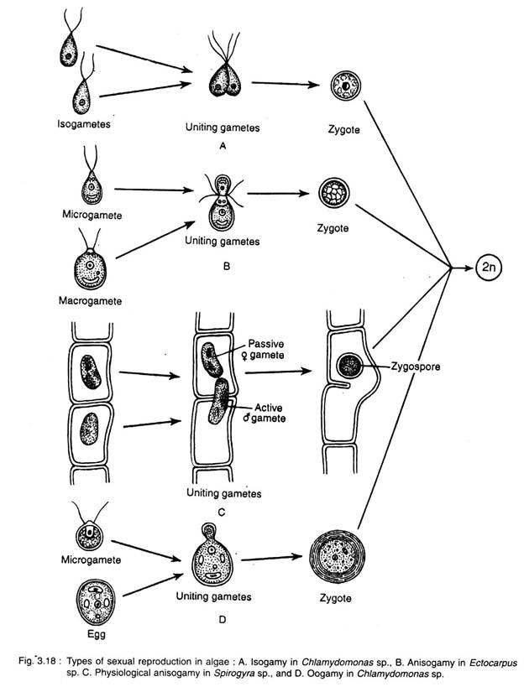
A - Isogamy
B - Anisogamy
C - Physiological Anisogamy
D - Oogamy

Slide 20
Anisogamy: In this process the uniting gametes are morphologically and phy­siologically different. The smaller and more active one is the microgamete (male), whereas the larger and less active one is the macrogamete (female), e.g., Chlamydomonas braunii.
Deviating from the typical anisogamy, when the uniting gametes show morphological simila­rity with physiological difference, it is called physiological anisogamy. e.g., Zygnema, Spiro­gyra etc.
Oogamy: It is an advanced process where fertilisation takes place between a small motile (non-motile in Rhodo- phyceae) male gamete (sperm or antherozoides) with a large non-motile female gamete (egg or ovum). Male gametes develop within antheridium, whereas the female gamete within the oogonium, e.g., Oedogonium, Vaucheria, Chara, Laminaria, Sargassum, Poly­siphonia, Batrachospermum etc.

Slide 21
There are Algae classification:
Chlorophyceae – These are called green algae, due to the presence of pigments chlorophyll a and b. Examples are Chlamydomonas, Spirogyra, and Chara
Phaeophyceae – Also called as brown algae, they are predominantly marine. They have chlorophyll a, c, carotenoids and xanthophyll pigments. Examples are Dictyota, Laminaria, and Sargassum
Rhodophyceae – They are the red algae because of the presence of the red pigment, r-phycoerythrin. Examples are Porphyra, Gracilaria, and Gelidium.
Diatomata - chlorophyll a and c, carotenoids
Blue – Green algae - chlorophyll a , Фикоцианин

Slide 22
Chlorophyta
Chlorophyta is a division of green algae contain chlorophylls a and b, and store food as starch in their plastids. There are many different species belonging to Chlorophyta; some are unicellular, some are multicelluar. The genome structures within Chlorophyta are all different. However, there are some common characteristics across species. Chlorophyta inhabit freshwater, marine and terrestrial habitats. Conditions for survival include light, carbon, essential nutrients, water quality, temperature and tidal exposure. Certain intertidal species such as the ulva, or sea lettuce, can tolerate a range of temperatures and survive drying at low tide. While most chlorophyta are aquatic.

Slide 24
1- General characteristics
1-Tend to grow well in summer, with ample light and nutrients and high temperature
2-Some filamentous forms may be inedible
3-Flagella may reduce tendency to sink
4-Many shapes and sizes but planktonic Chlorophyta tend to share a
characteristic: rapid growth potential

Slide 25
2-Cell Structure and Metabolism
Most Chlorophyta are unicelluar, but there are some multicelluar species.
Some are free-living, some are colonial, others are coenocytic. Filamentous sporophytes have singluar lenticular nuclei, which are embedded in a thick cytoplasm.
Chlorophyta usually have biflagellated gametes. Like other green plants, Chlorophyta contain chlorophylls a and b, although the major pigment is chlorophyll b.
In addition, some tropical species are pigmented by siphonoxanthin and siphonein. They store starches made from photosynthesis in double-membrane bounded chloroplasts. Cell walls are made of cellulose.

Slide 26
Parenchymatous
Siphonocladous
Fig.1: General Forms of Chlorophyta

Slide 27
Chlorophyta are photosynthetic organisms, obtaining starch from photosynthesis. They are autotrophic.
Fig.2: General structure of Chlorophyta

Slide 28
3- Reproduction and Life cycle
Chlorophyta reproduce both sexually and asexually, but usually sexually. Asexual reproduction can occurs by fission, fragmentation, or zoospores. Sexual reproduction can be isogamous, anisogamous, or oogamous. The species Ulva lobata experiences alternation of generations, alternating between haploid and diploid phases. In the haploid phase, gametes are formed; in the diploid phase, zoospores are formed. Not all species have this, however. For the species without alternation, meiosis occurs in the zygote.
Chlorophyta can exist as single cells, multi-cellular filaments or colonies. As single cells, green algae may be motile or moving, or nonmotile. An example of this unicellular organism is the fast growing chlorella that live inside animals.
Multi-cellular filaments can involve a life cycle that includes both sexual and asexual reproduction. The ulva, for example, goes through the process of alternation of generations or alternate forms of reproduction. Parents’ characteristics are recombined through the fusion of gametes, but reproduction also occurs through spores.
Colonies may consist of loose aggregates of single cells or an arrangement of cells in a pattern. These cells lack specialized functions. Reproduction occurs more rapidly with nearby mating cells. An example of a colony is the volvox, which has strands of cytoplasm-bonding individual cells. Hundreds of thousands of bright green cells form a sphere-shaped colony that uses its flagella to spin in the water.

Slide 29
Fig. 3: General Life cycle of Chlorophyta

Slide 30
3-1 Oedogonium Life Cycle
Asexual Reproduction Oedogonium is a form of filamentous green algae. It is capabable of reproducing asexually, which means that each oedogonium has both male and female reproductive organs. In asexual reproduction, the oedogonium fragments and produces zoospores. Zoospores are able to move spontaneously through the water. Once the zoospore is produced, it is released and is free to find a viable substrate. Once found, the zoospore's cells are able to divide and form a new filament of oedogonium.
Sexual Reproduction: Zygote Production
In addition to being able to reproduce asexually, the oedogonium is capable of reproducing sexually. In sexual reproduction, the filament portion of the oedogonium, called the antheridium, produces and releases sperm. The sperm sinks through the water until it meets with the filament portion of the oedogonium, called the oogonium, which contains a large egg. If the sperm successfully fertilizes the egg, a zygote is produced.
Sexual Reproduction: Zoospores
After the zygote is produced, it is released into the water and develops zoospores. The zoospores are similar to those created through asexual reproduction. Once the zoospores mature, the zygote splits open, releasing the zoospores. The zoospores then attach to the bottom of the sea and the cells in the zoospores divide to produce a new filament of oedogonium.

Slide 31
Fig.4: Life cycle of Oedogonium

Slide 32
4- Ecology
Cholorophyta are adapted to shallow water, and live in both freshwater and marine habitats. 90% of Chlorophyta are freshwater species. Those that live in marine habitats largely inhabit tropical environments. There are a small number of terrestrial species; these largely dwell on rocks or trees. Some species form symbiotic relationships with fungi, producing lichens. There are a few instances in which Chlorophyta have formed symbiotic relationships with animals.
The Chlorophyta species Caulerpa racemosa was introduced to the Mediterranean Sea in 1990. It was first observed in France in 1997, and has continued spreading. Many of the invaded locations are fishing areas. The Mediterranean Sea has many environmental factors that encourage the growth of Caulerpa racemosa, such as an ideal climate and substrata.
The species Spirogyra insignis is known to adapt to harsh conditions through spontaneous mutation. Flores-Moya et. al. (2005) studied the adaptation of this species in sulpherous waters. At first, its growth and reproduction was inhibited. However, the culture survived due to thegrowth of a resistant variant that formed before the culture was introduced to these sulfurous waters. This type of spontaneous mutation is what allows the species to survive.

Slide 33
5- Class Chlorophyceae
This group contains the largest number of species of the division. They can have two or more flagella, near the apex of the cell. Mitosis in this class involves phycoplasts, microtubules that develop between and separate the daughter nuclei. This characteristic is not seen in any other organism, implying that no organisms have descended from this class. There are a variety of asexual and sexual reproductive techniques. Sexual reproduction is characterized by the formation of a zygospore (a dormant diploid zygote protected by a thick wall) that later undergoes meiosis.
The class includes unicellular organisms such as those in the genus Chlamydomonas with their two apical flagella and nonmotile organisms such as Chlorella, which is being cultivated for use as a dietary supplement. Colonial genera of Chlorophyceae include Hydrodictyon (the "water net") and the so-called volvocine line of flagellated specimens that range from simple colonies of Gonium to the intricate spinning spheres of Volvox, which can consist of up to 60,000 cells and exhibit some cellular specialization. The most complex of the class are the filamentous members.

Slide 34
6- Class Ulvophyceae
Ulvophyceae contains marine organisms that take a variety of shapes that may consist of a few cells, long filaments, thin sheets of cells, or coenocytic cells. Most approach being radially symmetrical. They have an alternation of generations and unlike in the other classes, meiosis occurs in the spores rather than the zygotes. When present, there can be two or more apical flagella. During mitosis, the nuclear envelope and the mitotic spindle persist, as they do in the Charophyceae.
7- Class Charophyceae
Charophyceae are of great fossil age; the stoneworts date as far back as the late Silurian period. Cells of this class are asymetrical. Those that are motile have two flagella, at right angles near the apex of the cell. Sexual reproduction in this class, as in Chlorophyceae, is characterized by the formation of a zygospore and zygotic meiosis. Unlike in the other two common classes of green algae, but as with plants, the nuclear envelope disintegrates when mitosis begins. During cell division the mitotic spindle is present; in some a phragmoplast similar to those seen in plants aids in the formation of a cell plate. Plants are thought to have evolved from early species of Charophyceae.

Slide 35
The class includes Spirogyra, familiar filamentous algae that float on ponds and lakes in slimy masses. The desmids are single cells noted for their extraordinary symmetry and geometrical beauty. They are found only in fresh (usually still) water and often take an important place in the food chains of small nutrient-poor ponds and peat bogs. The stoneworts consist of a complex branched thallus with an erect stemlike structure and many whorls of short branches.

Slide 36
Phaeophyceae - Brown Algae
The Phaeophyta or brown algae are mostly marine algae. Phaeophyta are characterized by the pigment fucoxanthin that gives them the brown colour. The cell wall in Phaeophyta is two layered; inner layer consists of cellulose and outer layer mainly of algin and fucoidan. The brown seaweeds serve as important source of the industrial hydrocolloid alginate as well as food in countries like Japan, Korea and China.
General characteristics
(a) Occurrence: Mostly marine.
(b) Pigments: Fucoxanthin is dominant, Chlorophyll a, c and carotene.
(c) Pyrenoids: Stalked pyrenoids present outside the chloroplast envelope..
(d) Reserve food material: Laminarin, mannitol and fats.
(e) Cell wall: Cellulose, alginic acid and fucinic acid.
(f) Structure: Microscopic to branched, filamentous macroscopic parenchymatous plants.
(g) Flagella: Zoospores flagellated, flagella unequal, one is tinsel type.
(h) Reproduction: Sexual reproduction (isogamous, anisogamous and oogamous).

Slide 37
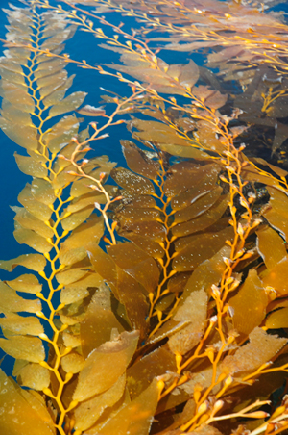
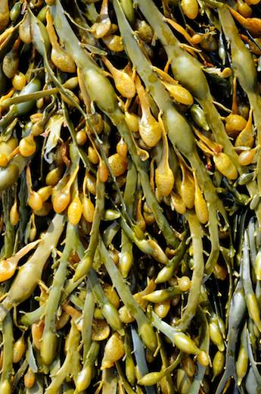
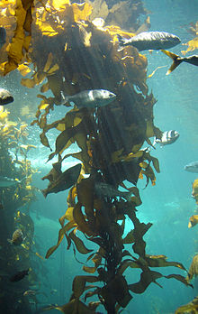
Structure
Most of brown algae are lithophytes , which require stable hard substrata for attachment, and a number of the fi lamentous, smaller species are epiphytes. Unicellular, colonolial and unbranched fi laments are absent inpheophyceae. The freshwater phaeophyta species are simply filamentous and smaller in size unlike their marine counterparts which have complex gigantic and bulky thalli Their size ranging from small fi lamentous forms like Ectocarpus and Hinskia , which are few millimetres to massive intertidal weeds such as Ascophyllum and Fucus , to subtidal large kelps and the largest seaweed known Macrocystis pyrifera, They have higher morphological and anatomical differentiation compared to the other algae The size range vary greatly, from crustose form which may be 1–2 mm, macroscopic fi lmentous tufts 2–10 mm, subtidal kelp forests that might be as tall as 20–60 m.
Fig. General Morphology of Brown Algae

Slide 38
The cell walls of brown algae are generally gelatinous and consist of two layers. Cellulose makes up the skeleton backbone but is present in small quantiites i.e. 1–8 % of dry weight. The chloroplasts of brown algae are usually discoid and surrounded by an envelope. The outer membranes of the chloroplast endoplasmic reticulum are continuous or discontinuous depending on the species. Microfibrils of DNA occurring in the plastid may be linear or circular attached to the thylakoid membranes. The pigments are located in plastids lacking pyrenoid; their presence may also vary according to algal stage.
Presence of Physodes (fucosan granules) is one of the characteristic features of brown algae. In the meristmatic, photosynthetic and reproductive cells, cytoplasm a large number of colourless vesicles with highly refractive acidic fl uid staining red with vanillin and hydrochloric acid are present.
Reproduction
Brown alga reproduces by vegetative, asexual and sexual methods of reproduction:
1- Vegetative Reproduction
Several species of brown algae show vegetative reproduction via fragmentation. In members of sphaecelariales propagules are found
2-Asexual Reproduction
All brown algae reproduce asexually with exceptions of Tilopetridales, Dictyotales and Fucales. In ectocarpales and spherocarpales asexual reproduction occurs via biflagellate zoospores that develops in to reproductive organs called sporangia which could be unilocular (onecelled) or many cells plurilocular as observed in Hinski amitchelliae. Gametes can also reproduce parthenogenetically to form asexual progenies, for example in Ectocarpus . Asexual reproduction is
absent in Laminaria

Slide 39
3-Sexual Reproduction
In pheophyceae sexual reproduction takes place by the formation of flagellate gametes that are formed inside gametangia. Multicellular gametangia are formed only in some of the brown algae , The haploid thalli form ranges from isogamous (both male and female gametes exactly similar), anisogamous (female gamete larger than male) to oogamous (small fl agellated male and large non-fl agellated female gametes), The sexual reproduction is through fusion of flagellated male and female gametes or fusion of flagellated male and large non-flagellated female gametes. The haploid (gametangial) and diploid (sporangial) thalli may be similar (isomorphic) as in Ectocarpales or different (heteromorphic) in appearance for example in Laminariales, or the gametangial generation may be extremely reduced (Fucales).
3-Life Cycle
Brown algal life cycle shows alteration of generations of haploid and diploid organisms:
1-Haploid gametophytes (n) give rise to haploid gametes by mitosis.
2-male and female gametes (n) fusion give rise to zygote (2n) that forms diploid sporophyte
3-The sporophyte (2n) produces meiospores (n) by meiosis which germinates and
4-forms haploid gametophyte.
5-Brown algae life cycle may be isomorphic, heteromorphic and Diplontic.

Slide 40
3-1 Life Cycle of Ectocarpus
The sexual life cycle of Ectocarpus consists of alternating heteromorphic gametophyte and sporophyte generations. Both generations of the sexual life cycle are multicellular. The sexual life cycle in the sporophyte generation starts with the formation of a diploid zygote that undergoes a bipolar germination to produce two germs tubes that eventually forms the sporophyte. The initial cell division in the zygote is symmetric. Two kindsof filaments prostrate and upright are produced in the sporophytic generation. Two specialized reproductive structures; plurilocular and unilocular sporangia are produced on the upright filaments.
A mitotic event in multi-chambered plurilocular sporangia releases mitospores, which after their release, forms sporophyte Unlike plurilocular sporangium, unilocular sporangium consists of single chamber that contain meiotically produced meiospores that give rise to multicellular gametophytes. Morphologically, it is hard to distinguish between a male and a female gametophyte. Like zygote, the meio-spores undergo a bipolar germination but the initial cell division of meio-spore is asymmetric that produces different cell types.
Only upright filaments have been observed in the gametophytic generation. Specialized reproductive structures called plurilocular gametangia are produced on the upright filaments of the gametophyte Plurilocular gametangia produce male and female gametes that are released in the surrounding marine water. Male and female gametes can be distinguished based on the behavior and physiology Unlike male gametes, female gametes settle quickly and release a sex pheromone that attracts male gametes. Once a male gamete fuses with a female gamete, a diploid zygote is produced that marks the onset of the first diploid structure of the sporophyte generation.

Slide 41
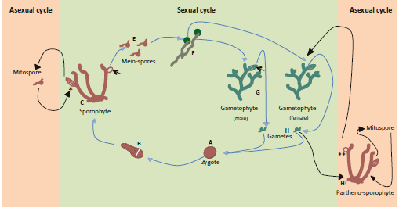
Fig.: General life cycle of Brown Algae (Ectocarpus)

Slide 42
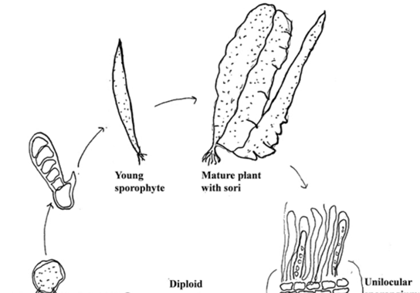
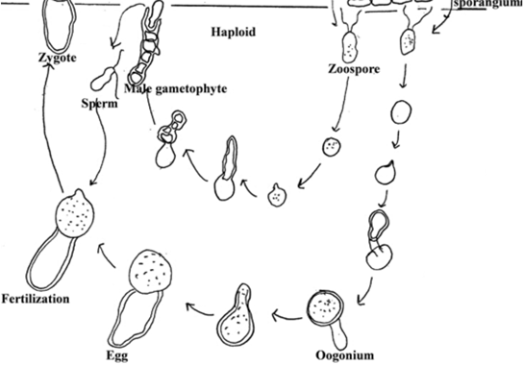
Fig.: Life cycle of Laminaria

Slide 43
Rhodophyceae
Lack of flagella and centrioles
Presence of photosynthetic pigments
Found both in marine and freshwater
They show biphasic or triphasic life cycle patterns.
Stored food is in the form of starch and polymers of galactan sulphate
A pit connection (hole in the septum) is formed between two algal cells.
Have a diffuse growth pattern- Apical growth, Complex oogamy (triphasic)
These group of red algae is generally found in tropical marine locations
The mode of nutrition may either be saprophytic, parasitic or also epiphytic.

Slide 44
Their cell walls consist of cellulose and many different types of carbohydrates.
Grow on solid surfaces independently or sometimes found attached to other algae.
Presence of pit in the cell walls, through which cytoplasmic connec­tions are maintained.
The male sex organs are known as spermatangium and the female sex organs are called carpogonia or procarp.
Mode of Reproduction: It takes place by all the three means: vegetative, asexual and sexual. Asexual mode of reproduction is by monospores and during the sexual mode of reproduction, they undergo alternation of generations.

Slide 45
Morphology
Red algal morphology is diverse ranging from unicellular forms to complex parenchymatous and non- parenchymatous thallus.Red algae have double cell walls.The outer layers contain the polysaccharides agarose and agaropectin that can be extracted from the cell walls as agar by boiling.The internal walls are mostly cellulose.They also have the most gene-rich plastid genomes known.

Slide 46
Cell structure
Red algae do not have flagella and centrioles during their entire life cycle. The distinguishing characters of red algal cell structure include the presence of normal spindle fibres, microtubules, un-stacked photosynthetic membranes, phycobilin pigment granules, pit connection between cells, filamentous genera, and the absence of chloroplast endoplasmic reticulum.

Slide 47
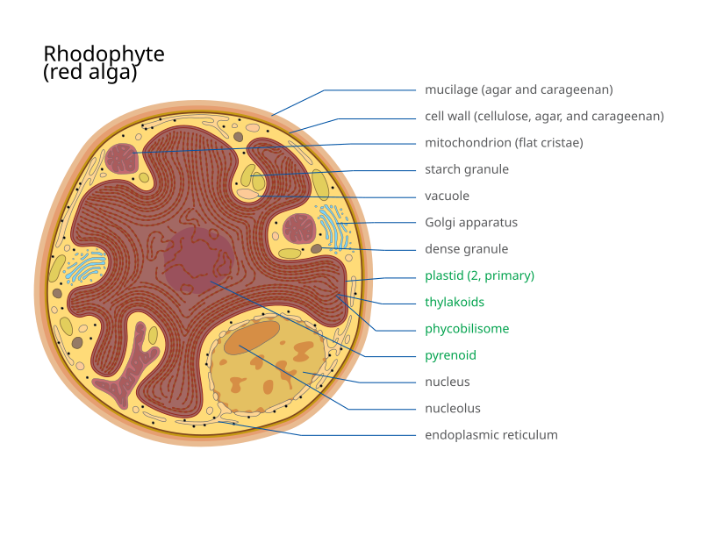

Slide 48
Chloroplasts
The presence of the water-soluble pigments called phycobilins (phycocyanobilin, phycoerythrobilin, phycourobilin and phycobiliviolin), which are localized into phycobilisomes, gives red algae their distinctive color. Their chloroplasts contain evenly spaced and ungrouped thylakoids and contain the pigments chlorophyll a, α- and β-carotene, lutein and zeaxanthin. Their chloroplasts are enclosed in a double membrane, lack grana and phycobilisomes on the stromal surface of the thylakoid membrane.

Slide 49
Storage products
The major photosynthetic products include floridoside (major product), D‐isofloridoside, digeneaside, mannitol, sorbitol, dulcitol etc. Floridean starch (similar to amylopectin in land plants), a long-term storage product, is deposited freely (scattered) in the cytoplasm.The concentration of photosynthetic products are altered by the environmental conditions like change in pH, the salinity of medium, change in light intensity, nutrient limitation etc. When the salinity of the medium increases the production of floridoside is increased in order to prevent water from leaving the algal cells.

Slide 50
Reproduction
The reproductive cycle of red algae may be triggered by factors such as day length. Red algae reproduce sexually as well as asexually. Asexual reproduction can occur through the production of spores and by vegetative means (fragmentation, cell division or propagules production).

Slide 51
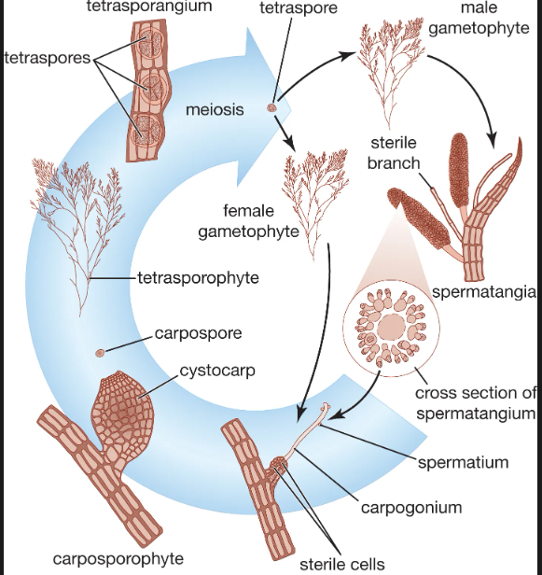

Slide 52
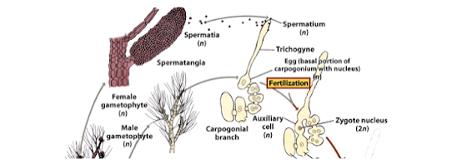
In red algae such as this Polysiphonia, tiny dust-like sperm cells, called spermatia, are released in great numbers from male plants. As the spermatia swirl around in the water, they are caught by the egg-producing structure on a female plant by long projections called trichogynes.

Slide 53
Uses of Red Algae
Algae provide natural food for fish and other aquatic animals.
Red alga is the most important commercial food in Japan and in the region of North Atlantic.
Agar or agar-agar, a jelly-like substance which is used in puddings, dairy toppings and other instant food products is extracted from Red algae.
Red algae are used as the source of food for thousands of years as they are high in vitamins, minerals, a rich source of calcium, magnesium, and antioxidants.
They are sources of dietary fibre as they have the ability to promote healthy circulation, lower bad cholesterol and regulate blood sugar levels.
They are also involved in nourishing your skin, boosting the immune system and contributing to bone health

